Slide 1


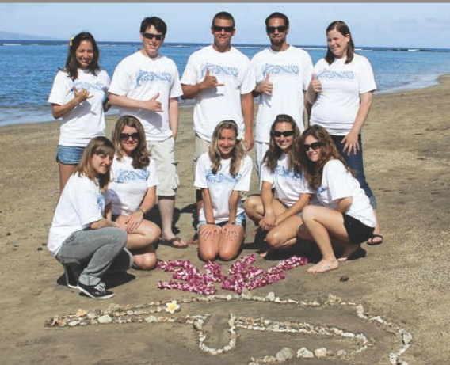
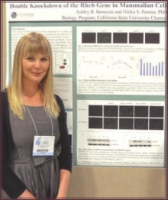
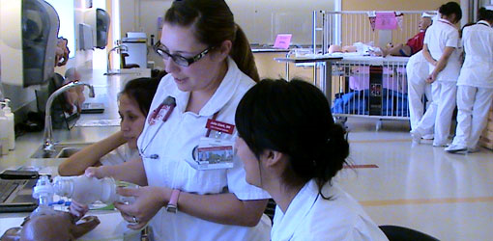


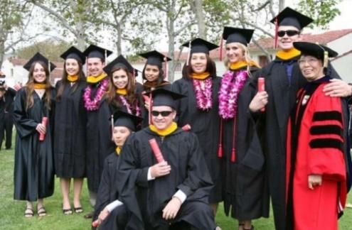
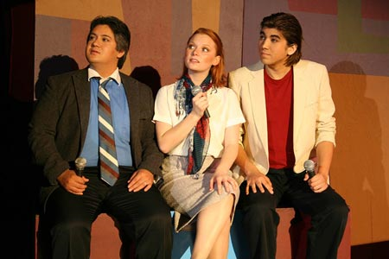

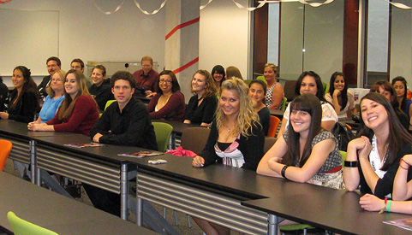


“Placing students at the center of the educational experience”

Slide 2
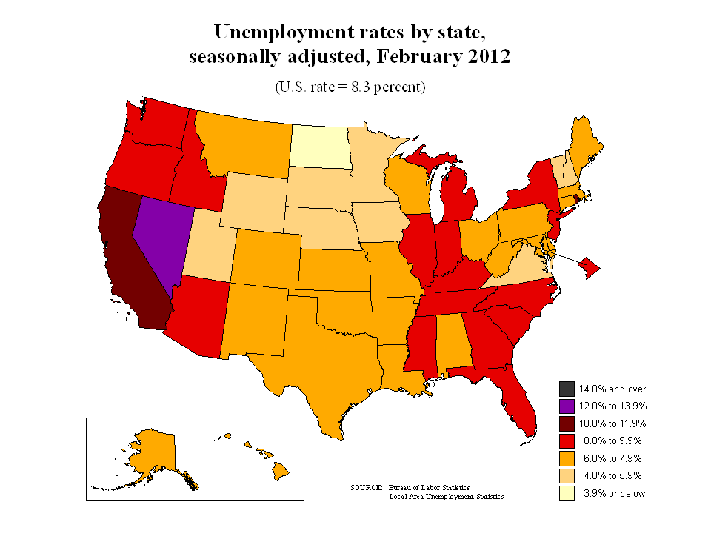
California Demographics, 2010
White | 40.1%
Hispanic | 37.6%
Asian | 13.0%
African American | 6.2%
Two or more groups | 1.7%
Native American | 1.0%
Pacific Islander | 0.4%
Poverty Rates, 2012
Los Angeles | 17.3%
Santa Barbara | 19.0%
Ventura | 10.6%
California | 15.7%
Cost of Living
Ventura | 45% 
Camarillo | 49.3 
Oxnard | 14.4% 
Source: U.S. Bureau of Labor Statistics Office of Occupational Statistics and Employment Projections
Notes:
… and in this context – the world has changed and in fact poverty in CA is often higher than the nations.. Probably even high than this – based on the high cost of living - $22K for a family of four.

Slide 3
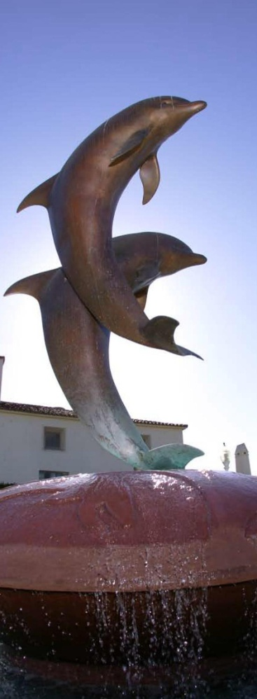
Content for today and campus strategic planning …
Change agents…
4-year residential and research vs for-profits
Students are seeing 4-year residential programs as expensive, problematic, and inflexible.
Three-year degree programs.
Universities offer one-year preparatory programs to high school students
Classroom discussions, office hours, lectures, study groups, and assignments will move on-line.
Faculty , less an oracle and more an organizer and guide; that is, someone who adds perspective and context.
Source: Chronicle of Higher Education (2012)
Notes:
As we start to think about our next campus strategic plan – I wound to place todays conversation in content.
I have been spending some time looking at our data under the supervision of Nelle, Jane and Terry –
At the same time, I am thinking of the academic affairs strategic plan, as well as the fact we will be looking at a new campus strategic plan – with an eye to what will be education in 2020 and beyond.
SA, my intention is to set the stage for the next stage of planning
Provide contexr for what is to come next
Touch on some of our achievements,
Try to consider areas of weakness., as we;;
Point out some areas of concern, as well
Give some history of where we are
Continue to develop a data-driven climate for decision making.
Provide a view of where we are right now
So, we should be thinking at both a 30,000 ftr and 2 foot at the same time.
And seek your help – you each have a 3.5 card – as I go along, you may think of other pieces of information that would be useful – please write it down– so that you don’t lose the idea.

Slide 4
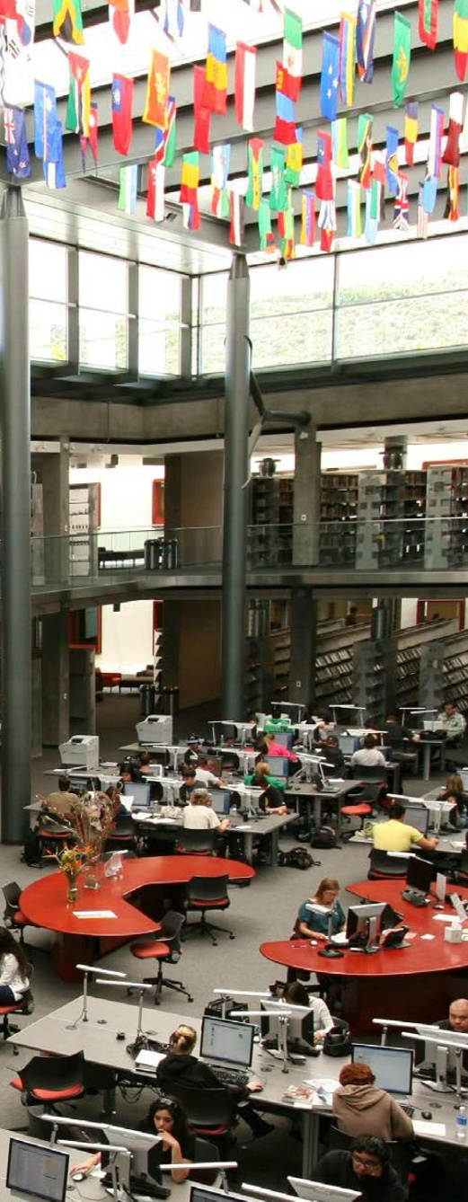
Fee Increases – 2004 to 2012
Source: CSU 2012
Notes:
As part of the conctect…
Remind you of our most recent history
Fees, furlough
I bring this up because of some data that may or may not reflect our most recent history.

Slide 5
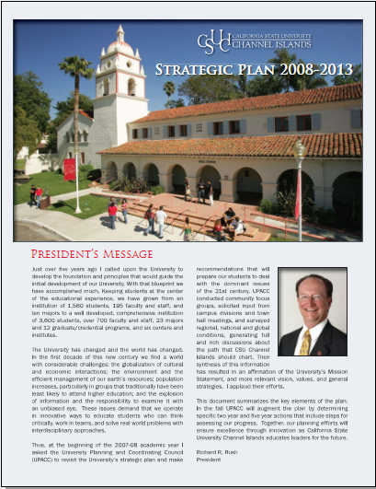


QUESTIONS
WHO ARE WE?
WHO DO WE SERVE?
HOW DO WE LOOK TODAY?
WHAT’S NEXT?
TOOLS
Strategic PLANNING
DATA
TITLE V
Graduation Initiative
ADMINISTRATION
FACULTY
STAFF
STUDENTS

Slide 6
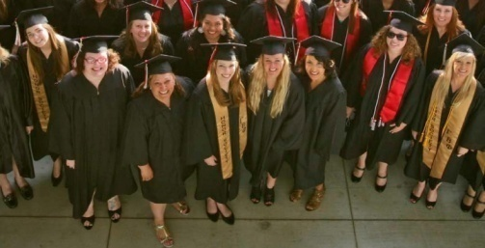
Who do we serve?
County | Fall 2009 |  | Fall 2010 |  | Fall 2011
Ventura | 674 | (56.0%) | 681 | (51.5%) | 666 | (47.7%)
Los Angeles | 208 | (17.3%) | 277 | (21.0%) | 297 | (21.3%)
Other California | 100 | (8.3%) | 97 | (7.3%) | 133 | (9.5%)
Santa Barbara | 60 | (5.0%) | 77 | (5.8%) | 107 | (7.7%)
San Diego | 43 | (3.6%) | 44 | (3.3%) | 46 | (3.3%)
Out-of-State | 39 | (3.2%) | 44 | (3.3%) | 24 | (1.7%)
Orange | 25 | (2.1%) | 33 | (2.5%) | 48 | (3.4%)
Riverside | 22 | (1.8%) | 22 | (1.7%) | 30 | (2.1%)
San Bernardino | 18 | (1.5%) | 30 | (2.3%) | 29 | (2.1%)
San Luis Obispo | 14 | (1.2%) | 17 | (1.3%) | 17 | (1.2%)
Source: ERS Enrollment Term Files
CI Institutional Research 3/13/12

Slide 7

Growth -FTEs (15 units = 1 FTEs)
 | Fall | Spring | Annual
2003 -04 | 1296 | 1327 | 1312
2004 -05 | 1656 | 1755 | 1706
2005 -06 | 2137 | 2109 | 2123
2006 -07 | 2640 | 2594 | 2617
2007 -08 | 3038 | 2842 | 2940
2008 -09 | 3271 | 3033 | 3152
2009 -10 | 3314 | 2950 | 3143
2010 -11 | 3279 | 3244 | 3271
2011 -12 | 3599 | 3581 | 3590
Source: ERS Student Census Files
CI Institutional Research 4/10/12

Slide 8
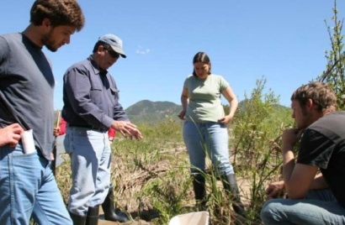
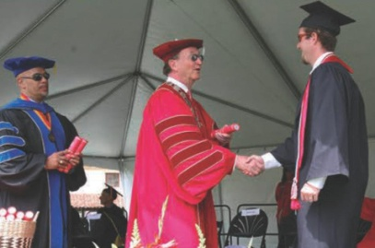
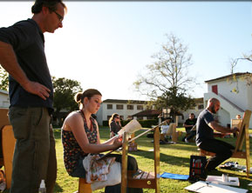

New Student Trends (headcount)
Number of New Students
 | Fall | Spring
2005-06 | 958 | 321
2006-07 | 1165 | 319
2007-08 | 1290 | 346
2008-09 | 1131 | 226
2009-10 | 1203 | 40
2010-11 | 1322 | 304
2011-12 | 1397 | 383
New Students, Fall, 2011
New Fresh.
Transfers
Grad
Credential
Post Bac
Source: ERS Enrollment Term Files
CI Institutional Research 3/13/12
Notes:
This slide is to show the transfers …
These are not all stuents – just the new ones… and the breakdown
Is this the same % of transfers in the rest of the CSU?

Slide 9

The ratio of “native” to “transfer” students has changed
Enrolled Undergraduate Students by Entry Status
Spr | Total (N) | Freshmen | Transfer
2007 | 2,781 | 38.9% | 61.1%
2008 | 3,179 | 42.0% | 58.0%
2009 | 3,213 | 45.9% | 54.1%
2010 | 3,164 | 49.6% | 50.4%
2011 | 3,504 | 47.7% | 52.3%
2012 | 3,934 | 46.3% | 53.7%
Enrolled Undergraduate Students by Entry Status
Fall | Total (N) | Freshmen | Transfer
2006 | 2,868 | 39.4% | 60.6%
2007 | 3,289 | 43.1% | 56.9%
2008 | 3,482 | 46.0% | 54.0%
2009 | 3,584 | 47.1% | 52.9%
2010 | 3,593 | 50.0% | 50.0%
2011 | 3,994 | 49.8% | 50.2%
“Entry Status” = whether students begin at CI as freshmen or transfer..
Source: ERS Student Census Files
CI Institutional Research 4/10/12
Notes:
This slides lets you get a good sense of the transfer-new student mix
In the fall – taking more freshman – fewer transfers since 2007
the

Slide 10

Percent Full-time Trends
Undergraduate Students
Fall Semester | Percent FT*
2002 | 55%
2003 | 70%
2004 | 70%
2005 | 74%
2006 | 80%
2007 | 78%
2008 | 81%
2009 | 83%
2010 | 83%
2011 | 83%
Fall 2011 New Students
 | Full-Time* | Part-Time
Native Freshmen | 98% | 2%
New Transfers | 73% | 27%
*Full-time = 12 or more credit hours
Source: ERS Enrollment Census Files
CI Institutional Research 3/28/12

Slide 11
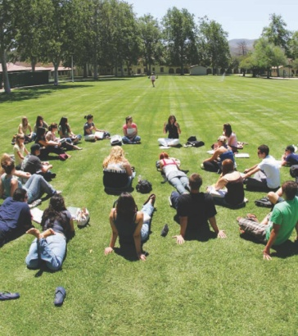
Our 2012 demographics are similar to that of the region.
Hispanic
White/Unk
Asian
Nat Am
Af Am
Source: http://quickfacts.census.gov
CI Institutional Research 3/13/12

Slide 12
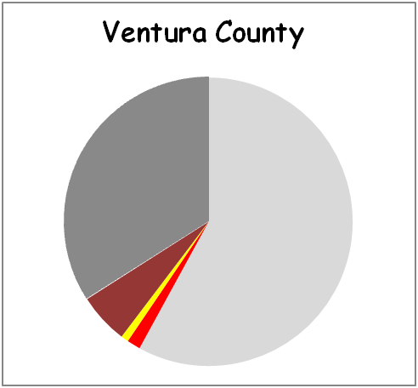
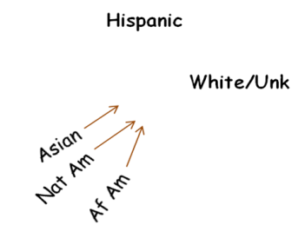

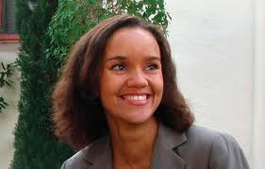

Who are the URMs?
Fall Term | Afr. Am. |  | Asian |  | Hispanic |  | Nat. Am. |  | White/Unk |  | Total
2007 | 90 | (3%) | 243 | (7%) | 922 | (26%) | 30 | (1%) | 2314 | (64%) | 3599
2008 | 94 | (2%) | 260 | (7%) | 956 | (25%) | 39 | (1%) | 2434 | (64%) | 3783
2009 | 73 | (2%) | 260 | (7%) | 989 | (26%) | 40 | (1%) | 2500 | (65%) | 3862
2010 | 85 | (2%) | 253 | (7%) | 1188 | (31%) | 34 | (1%) | 2268 | (59%) | 3828
2011 | 89 | (2%) | 285 | (7%) | 1260 | (30%) | 37 | (1%) | 2508 | (60%) | 4179
CI Institutional Research 4/10/12
Source: ERS Student Census Files

Slide 13
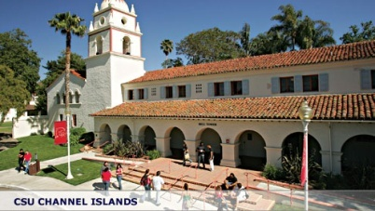
~ 27% of Fall 2011 students are 1st generation
 | Fall 2011 | Spring 2012
New Transfers | N= 714 | N=341
Non-URM | 466 (65%) | 216 (63%)
URM | 248 (35%) | 125 (37%)
Hispanic | 240 (34%) | 121 (35%)
1st Generation* | 196 (27%) | 86 (25%)
New Freshmen | N= 617 | -
Non-URM | 365 (59%) | -
URM | 252 (41%) | -
Hispanic | 221 (36%) | -
1st Generation * | 161 (26%) | -
* First Generation = neither parent has attended college
Source: ERS Enrollment Term Files
CI Institutional Research 4/10/12

Slide 14
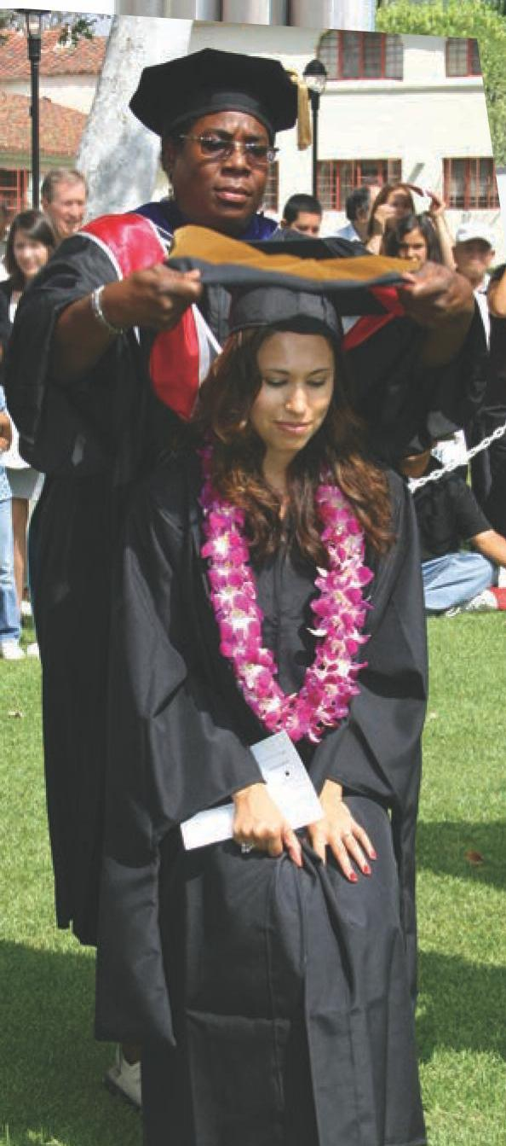
First Year Student Retention
Native Students | Non-URM | URM
2003-04 | 72% | 77%
2004-05 | 81% | 77%
2005-06 | 77% | 79%
2006-07 | 77% | 70%
2007-08 | 77% | 78%
2008-09 | 78% | 83%
2009-10 | 77% | 69%
2010-11 | 81% | 82%
Transfer Students | Non-URM | URM
2003-04 | 82% | 83%
2004-05 | 84% | 84%
2005-06 | 84% | 81%
2006-07 | 82% | 84%
2007-08 | 82% | 82%
2008-09 | 88% | 84%
2009-10 | 87% | 82%
2010-11 | 86% | 84%
“URM”; under-represented minorities (African American, Native American, Hispanic)
Source: CI Retention and Graduation Interactive Report
CI Institutional Research 4/10/12

Slide 15
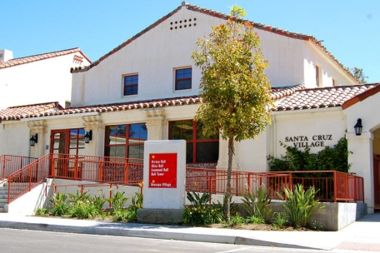
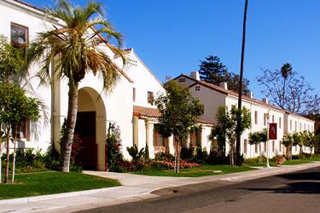
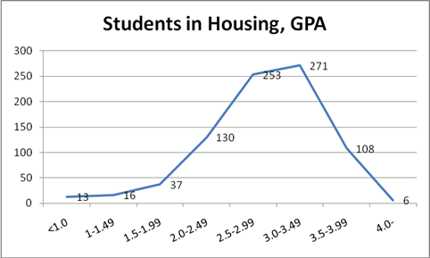
Retention of First Year Resident Freshmen
Fall 2010 337 FTE
Returned to Housing 45%
Retention 82%
Left CI 18%

Slide 16

First Year Academic Success
Fall 2010 | Afr Am | Asian | Hispanic | Nat Am | White/Unkn
Native Freshmen | N=26 | N=27 | N=185 | N=4 | N=252
Good Standing | 85% | 85% | 82% | 100% | 89%
Probation | 4% | 7% | 14% | 0% | 7%
Dismissed | 12% | 7% | 5% | 0% | 4%
Transfers | N=8 | N=34 | N=221 | N=6 | N=379
Good Standing | 75% | 94% | 89% | 83% | 95%
Probation | 13% | 3% | 4% | 0% | 2%
Dismissed | 13% | 3% | 7% | 17% | 3%
GPA of 2.0 or Better
Cohort | Native Freshmen | Transfers
2008 | 81% | 86%
2009 | 67% | 78%
2010 | 80% | 85%
“Academic Success” and in “Good Standing” = students who complete the first year with GPA of 2.0 or better; “Dismissed” = includes both academic and behavioral separations
Source: CI DataMart Archived Files
CI Institutional Research 3/14/12

Slide 17
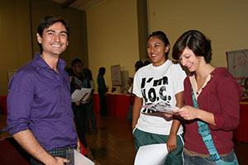
One Year Follow-up …
GPA 2.O or better after one year
 | Non-URM | URM
FA08 | 91% | 90%
FA09 | 87% | 83%
FA10 | 80% | 73%
“URM”; under-represented minorities (African American, Native American, Hispanic)
Source: CI One Year Follow-up Study
CI Institutional Research 4/10/12

Slide 18


Slide 19
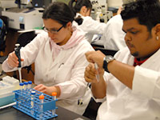
First Year Retention – STEM Majors
Retention by Enrollment Status
Cohort | Native Freshmen | Transfers
FA08 | 92% | 90%
FA09 | 89% | 95%
FA10 | 95% | 98%
Non-URM/URM Comparison
Cohort | Non-URM | URM
FA08 | 91% | 91%
FA09 | 93% | 89%
FA10 | 98% | 96%
“STEM”; students majoring in science, technology,
engineering, or math (excludes nursing)
“URM”; under-represented minorities (African American, Native American, Hispanic)
Source: Enrollment Dashboard
CI Institutional Research 3/14/12

Slide 20
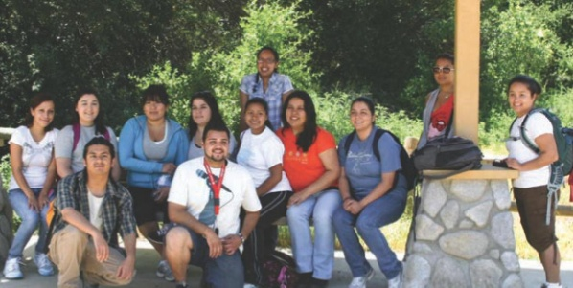
Degrees Awarded
 | BA/BS | Masters Degrees | Teacher Credentials
2003-04 | 142 | - | -
2004-05 | 346 | - | 62
2005-06 | 423 | 10 | 91
2006-07 | 402 | 21 | 98
2007-08 | 755 | 45 | 99
2008-09 | 802 | 63 | 105
2009-10 | 698 | 86 | 100
2010-11 | 872 | 88 | 117
Total | 4,440 | 313 | 672
27%
“URM”; under-represented minorities (African American, Native American, Hispanic)
Source: ERS Degree Term Files & Annual Credential Files
CI Institutional Research 3/28/12

Slide 21

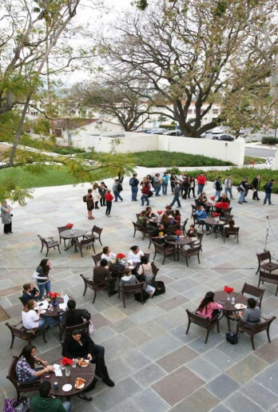
BA/BS by Ethnicity
AY 09-10
AY 10-11
Afr Am
Asian
Hispanic
White/ Unk
Natv Am
Source: ERS Degree Term Files
CI Institutional Research 4/10/12

Slide 22

Six Year Graduation Rate
Native Students | Non-URM | URM*
2003-04 | 53% | 48%
2004-05 | 58% | 55%
2005-06 | 54% | 48%
Transfer Students | Non-URM | URM*
2003-04 | 72% | 70%
2004-05 | 76% | 78%
2005-06 | 73% | 71%
“URM”; under-represented minorities (African American, Native American, Hispanic)
Source: CI Retention and Graduation Interactive Report
CI Institutional Research 3/14/12

Slide 23
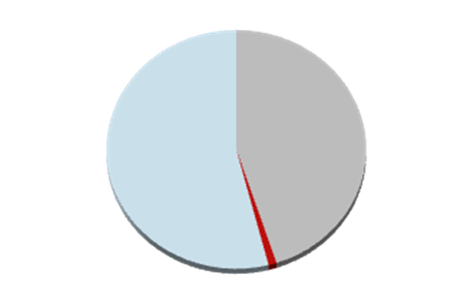
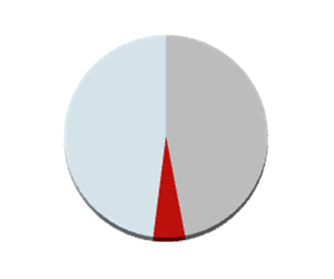
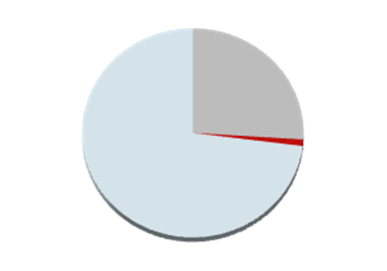
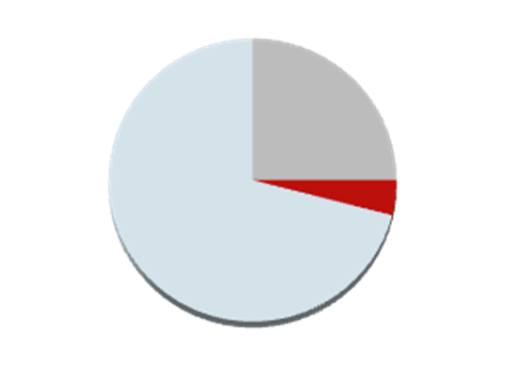
Six-Year Progress: 2005-06 Cohort
Non-URM*
URM*
Native
Freshman
Left campus
Enrolled
Graduated
Transfers
“URM”; under-represented minorities (African American, Native American, Hispanic)
Source: CI Retention and Graduation Interactive Report
CI Institutional Research 3/14/12

Slide 24

What about the students that did not complete?

Slide 25

Number of “eligible” students that transferred or dropped at semester’s end
Source: CI DataMart and NSLC data
CI Institutional Research 3/28/12

Slide 26
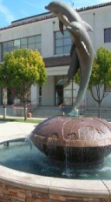
Students That Left CI (Fall 09 to Fall 2011)
 | Dropped out | Transferred
Female | 36% | 31%
Male | 64% | 69%
Age 17-24 | 33% | 37%
Age > 25 | 67% | 63%
URM* | 21% | 16%
VC Residents | 36% | 21%
HS GPA > 3.0 | 60% | 70%
CI GPA > 3.0 | 34% | 38%
English – Low Test Scores | 31% | 34%
Math – Low Test Scores | 21% | 33%
“URM”; under-represented minorities (African American, Native American, Hispanic)
Source: CI DataMart and NSLC data
CI Institutional Research 4/10/12

Slide 27

Plans After Graduation, Spring 2011
Survey Responses | # Responses
1. Look for a job | 379
2. Have a job in my field of study | 110
3. Have a job in another field | 74
4. Grad School | 308
4a. Admitted | 34
4b. Have applied or will apply | 274
5. Moving out of area | 91
6. Start a family | 54
7. Don’t know/Other | 50
8. Other | 20
Total Surveys Received | 679
Graduate Schools
Antioch University
Azusa Pacifica
CLU
CSU Channel Islands
CSU Long Beach
CSU Northridge
Harvard
La Verne
Medical School
Midwestern Dental School
National University
Nursing School
Univ of Pacific, Dental
Western
Yale University
Source: Gradfest Survey of Future Plans
CI Institutional Research 4/10/12

Slide 28

CI Strategic Plan
2019
"What do we do?"
"For whom do we do it?"
"How do we excel?"
2013
Vision, Mission, Values
Draw -ideal end state?
See -today's situation; ID the gap from ideal and why?
Think -specific actions; to reach the ideal
Plan -what is required to execute

Slide 29
Academic Affairs Strategic Plan: 2011-16
Initiatives | In Two Years | In Five Years
Actively support the University Strategic Plan- Student Access, Retention and Success; Sustainability STEM (science, technology, engineering, mathematics) Crisis; Wellness | Enhance undergraduate research opportunities; Create a data-driven-climate  Adopt STARS—improve compliance; Build relationships with 2 year feeder schools;  Increase enrollments in STEM;  Promote culture of wellness. |  Improve T/T to Lecturer ratio; Plan effective growth including GE changes;  Increase STARS compliance;  Increase enrollment, and graduation rates;  Add new degree tracks in STEM disciplines;  Implement programs to support wellness of faculty, staff and students.
Fully implement assessment processes leading to continuous improvement. |  Complete baseline for all programs including Centers;  Prepare a comprehensive array of assessment instruments;  Enhance resource allocation to assessment. |  Fully implement assessment plans for all academic programs (including GE);  Complete program reviews for all academic programs (including GE);  WASC re-accreditation received
Create and implement a first, second and transfer year programs |  Implement first year and transfer experience (ISLAS) |  Implement second year experience.

Slide 30




I Fell into a Burning Ring of Fire,
“Deliverology” (late, 2009)
EMSSC (2003-2007)
CARS (2007-2010);
CAG (2010 - 2011)
Graduation Initiative
Student Success Partnership
“Deliverology” - Michael Barber
CARS, Committee on Access, Retention, Success
CAG, Closing the Achievement Gap
EMSSC, Enrollment Management and Student Success

Slide 31

CAG
SSP
EMSSC
CARS
GI

Slide 32


Student Success Partnership (SSP)
The SSP Steering Committee, deploys small, short-term
task forces to research and make recommendations
TF1 Assignment: Inventory best practices for at-risk students;
  Outcome: Provided chairs with names of non-returners by program.
TF2 Assessment: How are students accessing and understanding advising?
  Outcome: Provided chairs with Early Warning letter
TF3 Assignment: What resources do students access?
  Outcome: Faculty advisors learn CARR
  Outcome: Reach out to undeclared students
TF4 Assignment: What can we do about helping poorly prepared students?
  Outcome: Personal follow-up with 2.2 and below students.
TF5 Assignment: What can we do about helping at risk students?
  Outcome: Targeted advising to those who fail first year math/English

Slide 33


